Slide 1
STRATEGIC MARKETING
Services Marketing and Service Dominant Logic
Prof. Mohammed Rafiq
Professor of Marketing

Slide 2
Agenda
Explain difference between physical products and services
Explain the extended Marketing Mix
Discuss the Services Marketing Triangle (between External Marketing, Internal Marketing and Interactive Marketing)
Explain Service quality
Discuss Service Dominant Logic

Slide 3
What is a product?
Products, services and experiences
Product is anything that can be offered in a market for attention, acquisition, use or consumption that might satisfy a need or want.
Service is a product that consists of activities, benefits or satisfaction that is essentially intangible and does not result in the ownership of anything.

Slide 4
What is a product? (Continued)
Products, services and experiences
Experiences represent what buying the product or service will do for the customer.

Slide 5
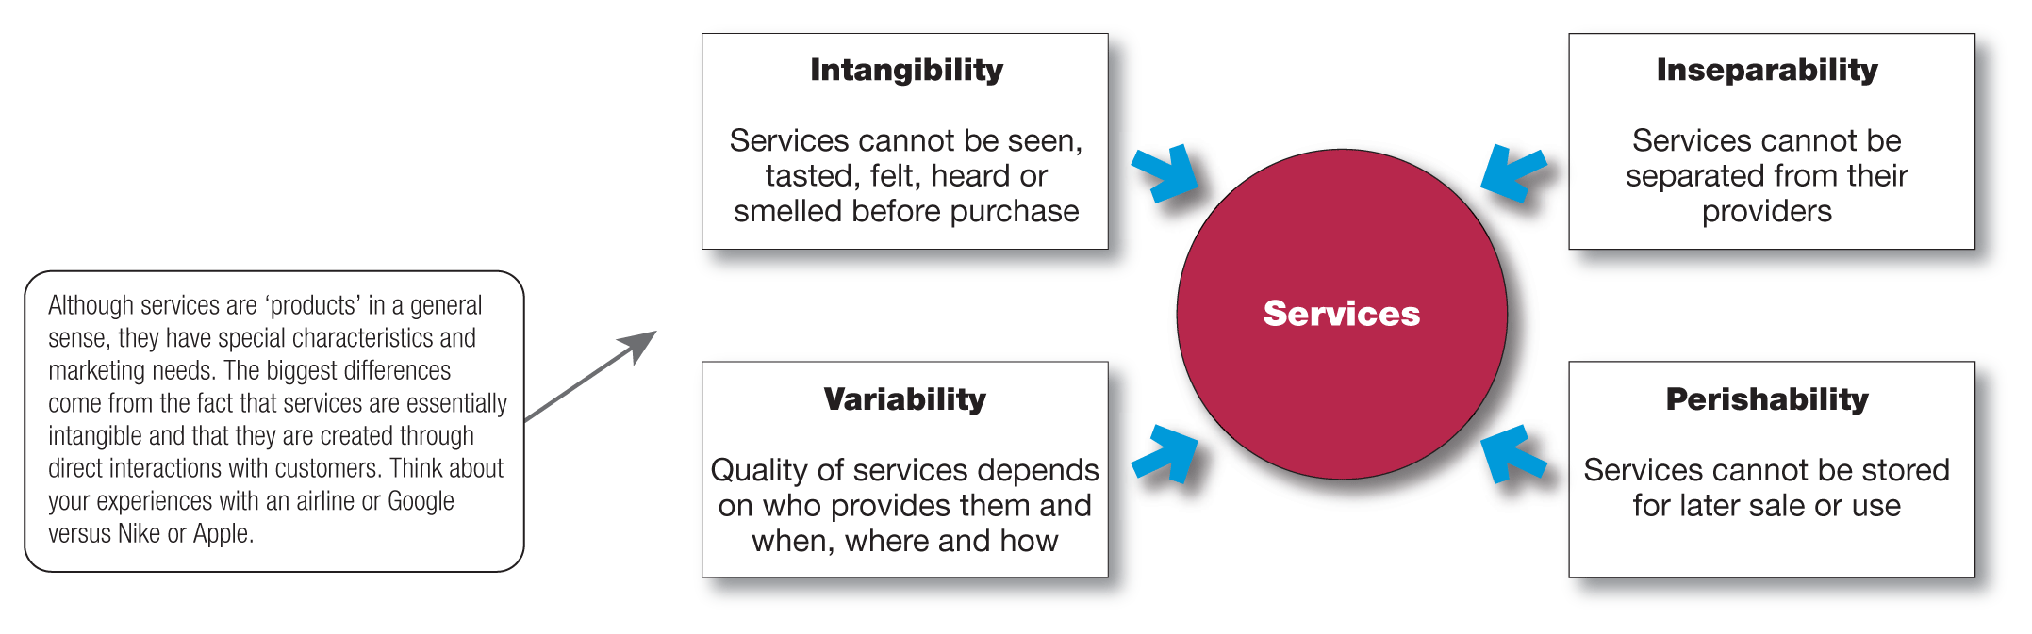
Services marketing (Continued)
The Nature and characteristics of a service

Slide 6
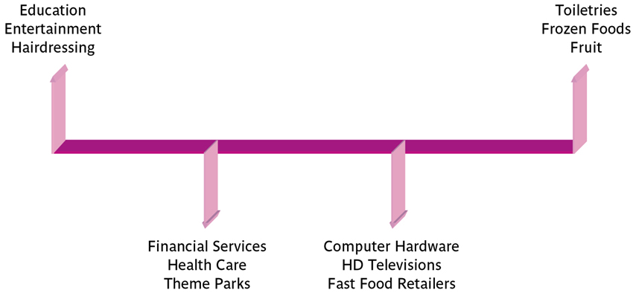
The Good / Service Spectrum
The good/service spectrum identifies that there are some product offerings that have very few services and some that have little good tangibility.

Slide 7
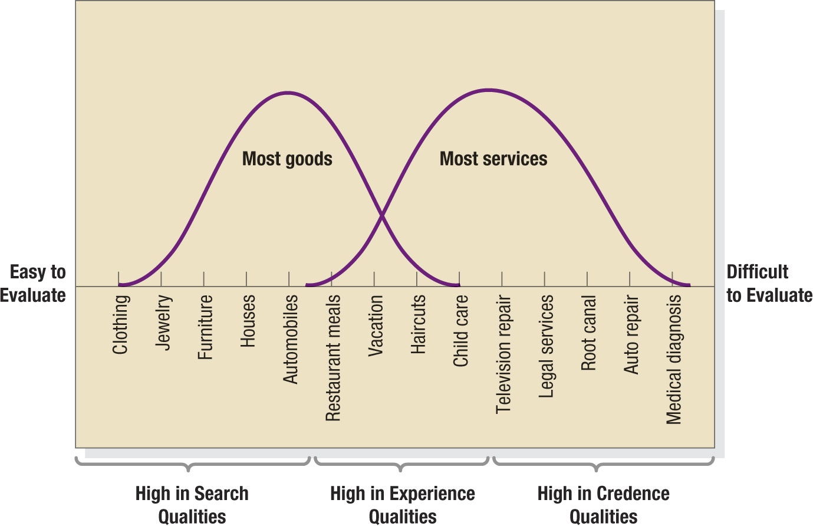
Continuum of Evaluation for Different Types of Products
Zeithaml (1981).

Slide 8
Levels of Customer Confidence
Search properties are those elements that help customers to evaluate an offering prior to purchase
Experience properties do not enable evaluation prior to purchase (e.g sprting events, entertainmen. And holidays)
Credence properties relate to those service characteristics that even after purchase and consumption customers find difficult to evaluate.

Slide 9
Services marketing
Marketing strategies for service firms
In addition to traditional marketing strategies, service firms often require additional strategies.
Extended Marketing Mix
Service profit chain
Internal marketing
Interactive marketing.

Slide 10
Traditional Marketing Mix
All elements within the control of the firm that communicate the firm’s capabilities and image to customers or that influence customer satisfaction with the firm’s product and services:
Product
Price
Place
Promotion

Slide 11
Extended Marketing Mix for Services –The 7 Ps
Product
Price
Place
Promotion
People
All human actors who play a part in service delivery and thus influence the buyer’s perceptions: namely, the firm’s personnel, the customer, and other customers in the service environment.
Physical Evidence
The environment in which the service is delivered and where the firm and customer interact, and any tangible components that facilitate performance or communication of the service.
Process
The actual procedures, mechanisms, and flow of activities by which the service is delivered—the service delivery and operating systems.

Slide 12
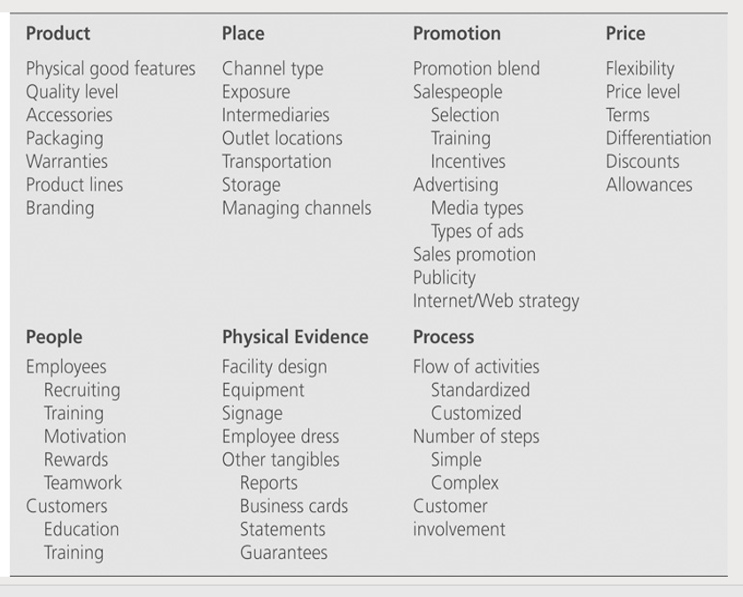
Extended Marketing Mix for Services

Slide 13
Services marketing (Continued)
Marketing strategies for service firms
Service profit chain links service firm profits with employee and customer satisfaction.
This chain consists of five links:
Internal service quality
Satisfied and productive service employees
Greater service value
Satisfied and loyal customers
Healthy service profits and growth.

Slide 14
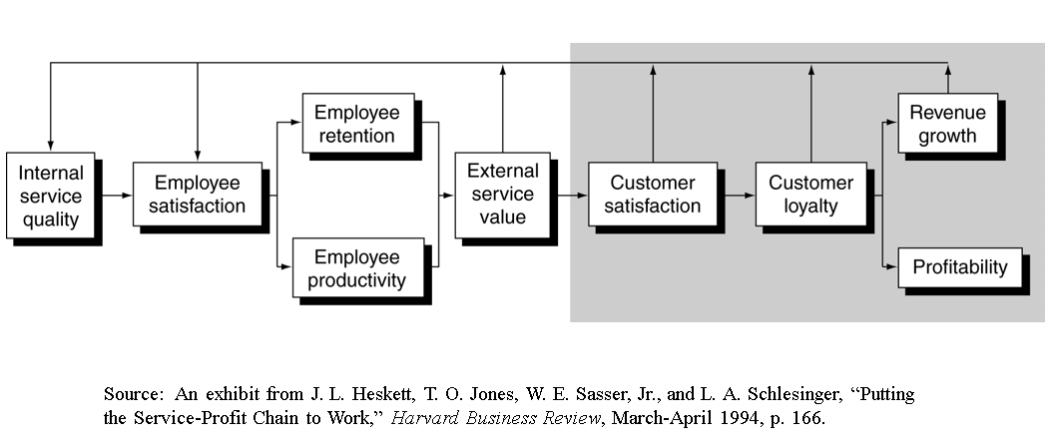
Service Profit Chain

Slide 15
Services marketing (Continued)
Marketing strategies for service firms
Internal marketing means that the service firm must orient and motivate its customer-contact employees and supporting service people to work as a team to provide customer satisfaction.
Internal marketing must precede external marketing.

Slide 16
Services marketing (Continued)
Marketing strategies for service firms
Interactive marketing means that service quality depends heavily on the quality of the buyer–seller interaction during the service encounter.
Service differentiation
Service quality
Service productivity.

Slide 17
The Service Marketing Triangle
Company
(Management)
Internal Marketing
External Marketing
“Enabling the promise”
“Making the promise”
Providers
Customers
Interactive Marketing
“Delivering the promise”
11-17
Source: Adapted from Mary Jo Bitner, Christian Gronroos, and Philip Kotler

Slide 18
Services marketing (Continued)
Marketing strategies for service firms
Managing service differentiation creates a competitive advantage from the offer, delivery and image of the service.
Offer can include distinctive features(Customisation).
Delivery can include more able and reliable customer contact people, environment or process.
Image can include symbols and branding.

Slide 19
Services marketing (Continued)
Marketing strategies for service firms
Managing service quality provides a competitive advantage by delivering consistently higher quality than its competitors.
Service quality always varies depending on interactions between employees and customers.

Slide 20
Approaches to Service Quality Measurement
Performance measures
Disconfirmation
Derived from the manufacturing sector this approach simply asks customers to rate the performance of a service encounter. SERVPERF is the standard measurement technique.
This approach is based on the difference between what was expected from a service and was delivered, as perceived by the customer. SERVQUAL is the standard measurement technique.
Importance-
Performance
Seeks to compare the performance of the different elements that make up a service with the customer’s perception of the relative importance of these elements. IPA (importance-performance analysis) is the standard measurement technique.

Slide 21
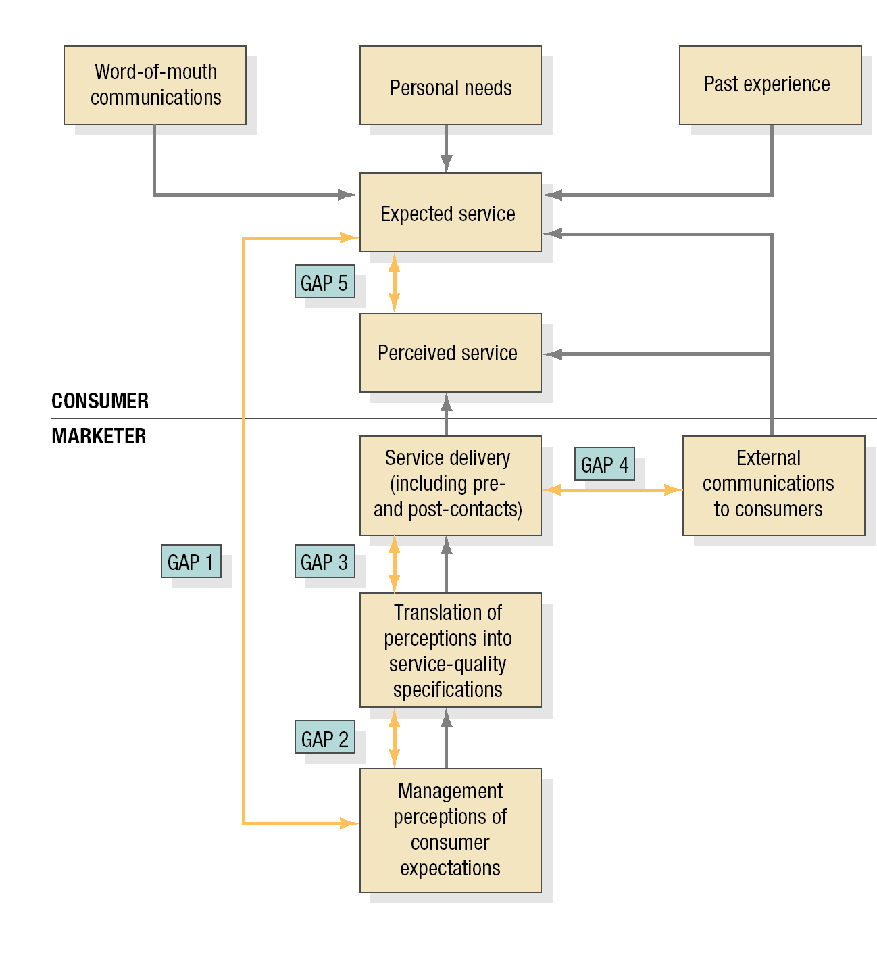
Service Quality Gap Model
Source: Parasuraman et al. 1985

Slide 22
SERVQUAL
SERVQUAL is a disconfirmation model and is based on the difference between the expected services and the actual perceived service.
Using this GAPS approach five different dimensions of service-quality have been established. These are:
Reliability – the accuracy and dependability of repeated performances of service delivery.
Responsiveness – the helpfulness and willingness of staff to provide prompt service.
Assurance – the courtesy, confidence and competence of employees.
Empathy – the ease and individualised care shown towards customers.
Tangibles – the appearance of employees, the physical location and any facilities and equipment, and the communication materials.

Slide 23
Services marketing (Continued)
Marketing strategies for service firms
Managing service productivity refers to the cost side of marketing strategies for service firms
Employee recruiting, hiring and training strategies.
Service quantity and quality strategies.

Slide 24
Goods-dominant (G-D) Logic
Purpose of economic activity is to make and distribute units of output, preferably tangible (i.e., goods)
Goods are embedded with utility (value) during manufacturing
Goal is to maximize profit through the efficient production and distribution of goods
goods should be standardized, produced away from the market, and inventoried till demanded
Firms exist to make and sell goods

Slide 25
Service(s): The G-D Logic Perspective
Services are:
Value-enhancing add-ons for goods, or
A particular (somewhat inferior) type good, characterized by:
Intangibility
Heterogeneity (non-standardization)
Inseparability (of production and consumption)
Perishability

Slide 26
Problems with Goods Logic
Goods are not what we fundamentally “own” to exchange
Application of knowledge and skills (our services)
Goods are not all that “good”
Tangibility is not fundamentally why we buy goods
It is for the service they render
Benefits are generally intangible – brand, image, meaning, experience
Standardization ignores individual preferences
Value (customer determined) is very perishable
Inventory of tangible goods is resource depleting

Slide 27
Problems with Goods Logic
Focuses on what we make, not what we do for people
What customers need
“Consumer orientation” does not help
Focuses on efficiency of output processes rather than effectiveness of resource application (inputs)
Does not inform (misinforms) firm transition to service

Slide 28
Service-Dominant Logic Basics
A logic that views service, rather than goods, as the focus of economic and social exchange
i.e., Service is exchanged for service

Slide 29
Service-Dominant Logic Basics
Essential Concepts and Components
Service: the application of competences for the benefit of another entity
Service (singular) is a process—distinct from “services”— particular types of goods
Sees value as always co-created
Sees goods as appliances for service delivery
Implies all economies are service economies
All businesses are service businesses

Slide 30
The Inversion of the G-D Model
Goods Logic Service Logic
Products (units of output)
Service (processes—applied competences)
Goods
Services (Intangible goods)
Indirect (Goods--Appliances)
Direct (service)

Slide 31
Conceptual Transitions from Goods-Dominat to Service-Dominant Logic
Goods-Dominant Concepts
Goods
Products
Feature/attribute
Value-added
Profit maximization
Price
Equilibrium systems
Supply Chain
Promotion
To Market
Product orientation
Transitional Concepts
Services
Offerings
Benefit
Co-production
Financial Engineering
Value delivery
Dynamic systems
Value-Chain
Integrated Marketing Communications
Market to
Market Orientation
Service-Dominant Concepts
Service
Experiences
Solution
Co-creation of value
Financial feedback/learning
Value proposition
Complex adaptive systems
Value-creation network/constellation
Dialog
Market with
Service-Dominant Logic (Consumer and relational)

Slide 32
Potential Implications of S-D Logic
Making “services” more “goods-like” (tangible, separable, etc.) may not be correct normative marketing goal
Make goods-more service-like.
Reconsider the primary nature of the firm
From manufacturing (make and sell) to marketing
resource utilization for service provision
Outsource manufacturing and other non-core competences
Virtual, “on demand” modular marketing organizations

Slide 33
Potential Implications (2)
Selling service flows rather than ownership, even when goods are involved
Shifting to Value-Based Pricing
Based on value-in-use
Network to network marketing
Resource integration for resource integrators

Slide 34
Sub-disciplinary Divergences and Convergences
Business-to-Business Marketing
From differences
Derived demand, professional buyers, fluctuating demand, etc
To emerging new principles
Interactivity, relationship, network theory, etc
Service(s) Marketing
From differences:
Inseparability, heterogeneity, etc.
To emerging new principles:
Relationship, perceived quality, customer equity, etc.

Slide 35
References
Vargo, S. L. and R.F. Lusch (2004) “Evolving to a New Dominant Logic of Marketing,” Journal of Marketing
Lusch, R.F., S.L. Vargo, and M. O’Brien (2007), “Competing Through Service: Insights from Service-Dominant Logic,” Journal of Retailing

